Slide 1
Imagine all your training tools in one easy-to-use platform.

Slide 2
Recordkeeping & Certification Tools

Slide 3
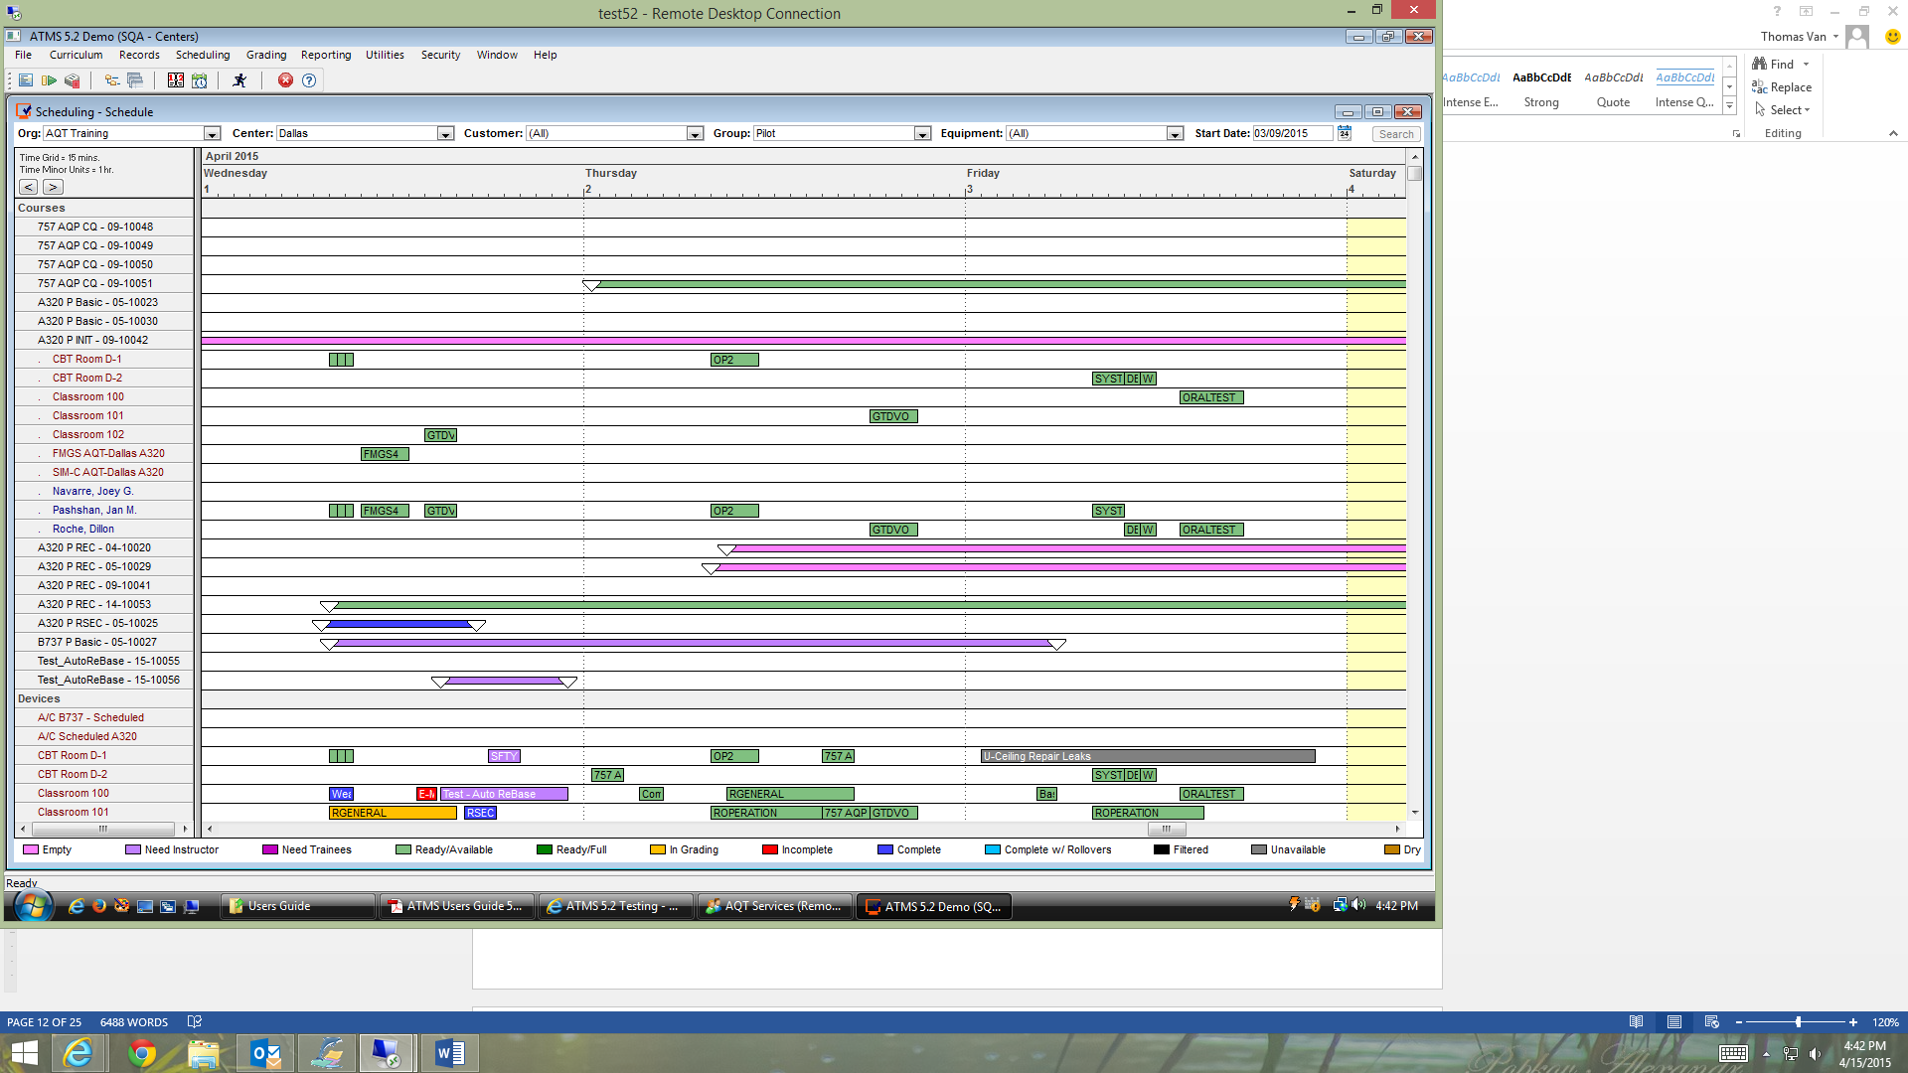
Recordkeeping & Certification Tools

Slide 4
Less hassle. More control. Schedule a demo now.

